Slide 1






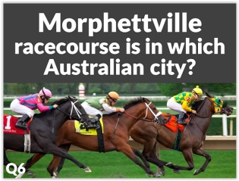
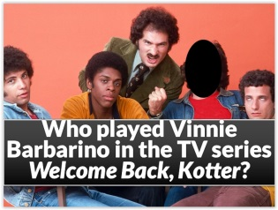

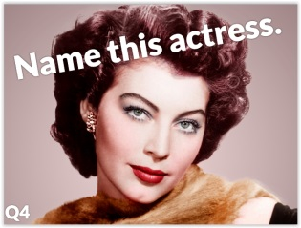
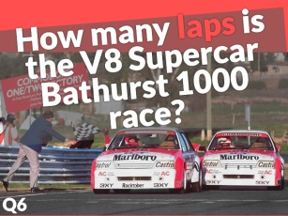
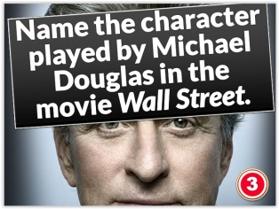
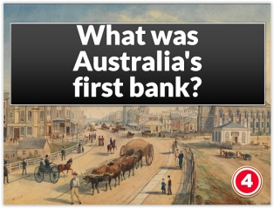

Slide 2
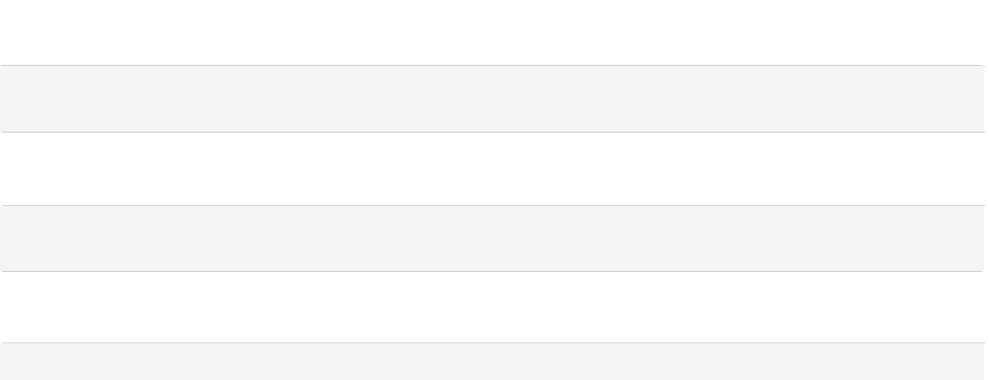
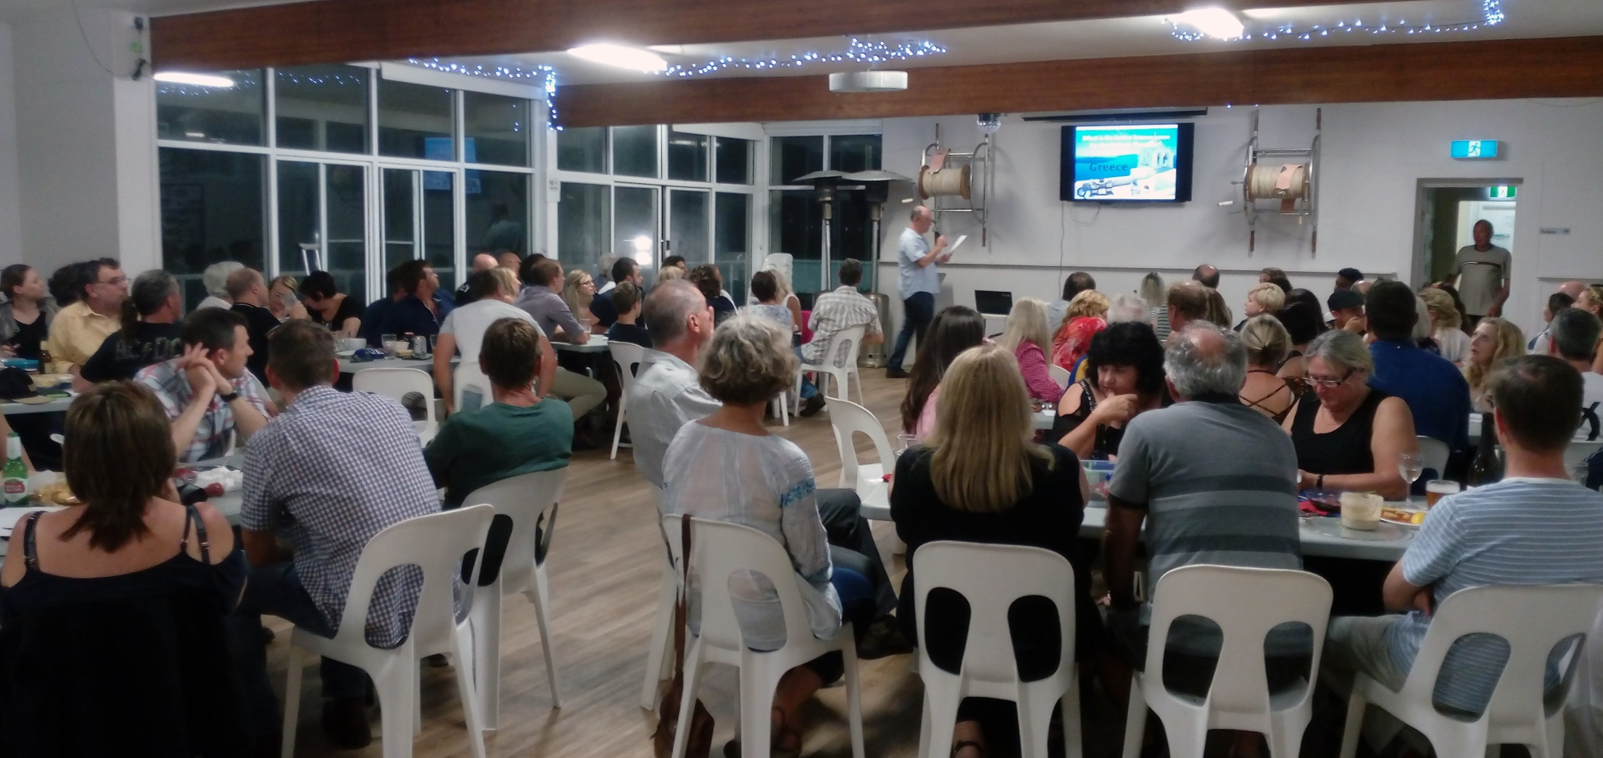


We’re a small, enthusiastic team of trivia masters based in NSW who’ve been creating slideshow trivia for over ten years.
Our Mission?
To provide quality entertainment to clubs and pubs in the city and the bush.

Slide 3



Each General Knowledge Slideshow includes:
Timed (Beat the Clock) and Traditional (untimed) slideshows
5 x 10 questions and answers (100 slides)
1 x novelty round for each table
1 x Who Am I?
1 x True of False
All instructions and playing paperwork included (in .pdf format for easy printing)
Games you can choose to incorporate
Ideas on how to maximise your return for the evening

Slide 4
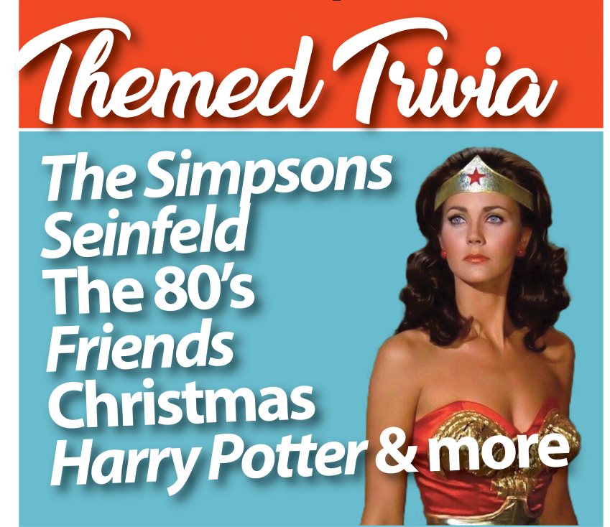
Each Themed Slideshow includes:
Timed (Beat the Clock) and Traditional (untimed) slideshows
4 x 10 questions and answers (80 slides)
2 x novelty rounds for each table
All instructions and playing paperwork included (in .pdf format for easy printing)
Games you can choose to incorporate
Ideas on how to maximise your return for the evening

Slide 5















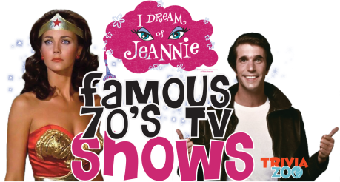



Slide 6





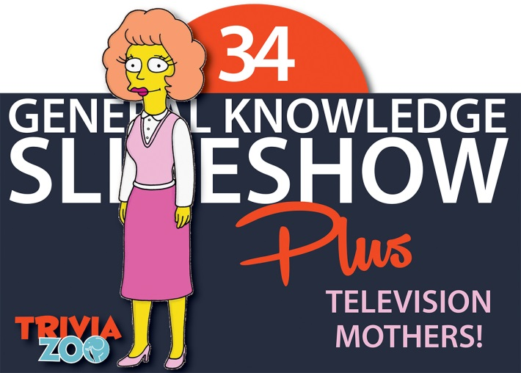





Slide 7



We have used the Trivia Zoo Pub & Club Trivia Packs at our venue for over 12 months and can highly recommend them. Our weekly trivia night patronage has increased during this time and our players enjoy the varied questions, fun games and slideshows. We have also recently begun using the Trivia Zoo Themed slideshows which has attracted a whole new group of players for a very fun filled event. Trivia Zoo’s customer service has been excellent and the team is always accommodating. Thanks Trivia Zoo.
SCOTT, CLUB MANAGER - NSW

Slide 8









All purchases are made online
Download is immediate on payment
Multiple downloads of each product available
No contracts
Friendly 24-hr support
For all terms and conditions please visit www.triviazoo.com.au

Slide 9



Slide 10



Slide 11
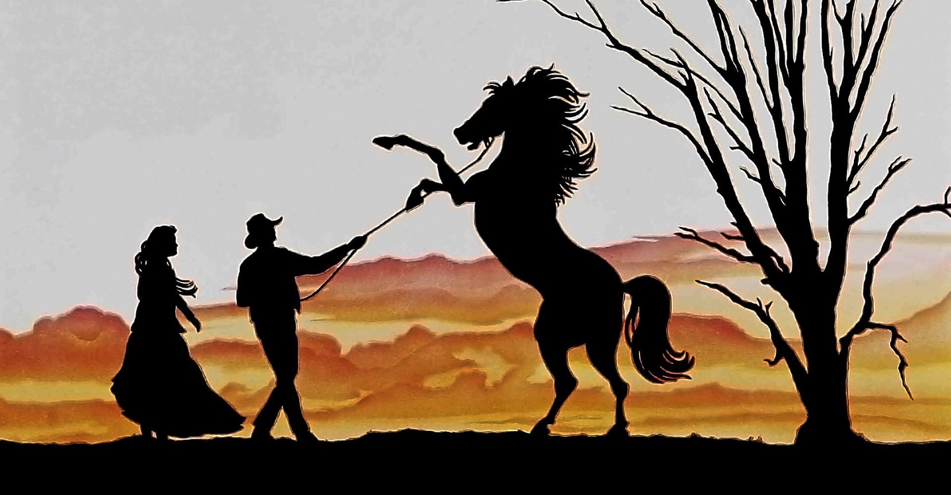
Who wrote the poem The Man from Snowy River?
1

Slide 12
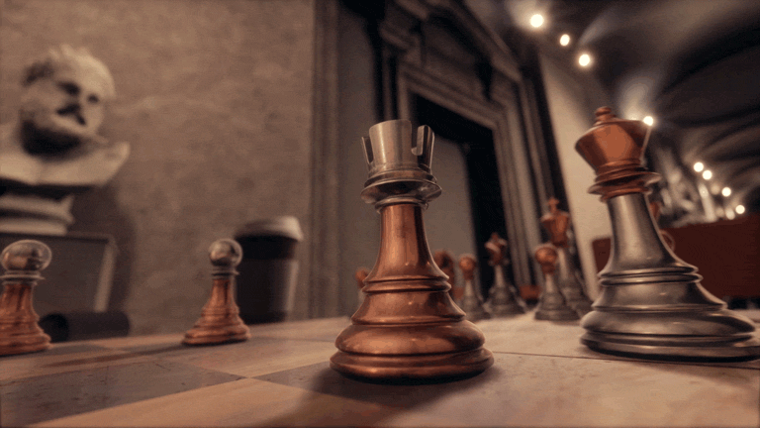
How many black squares are there on a chess board?
2

Slide 13
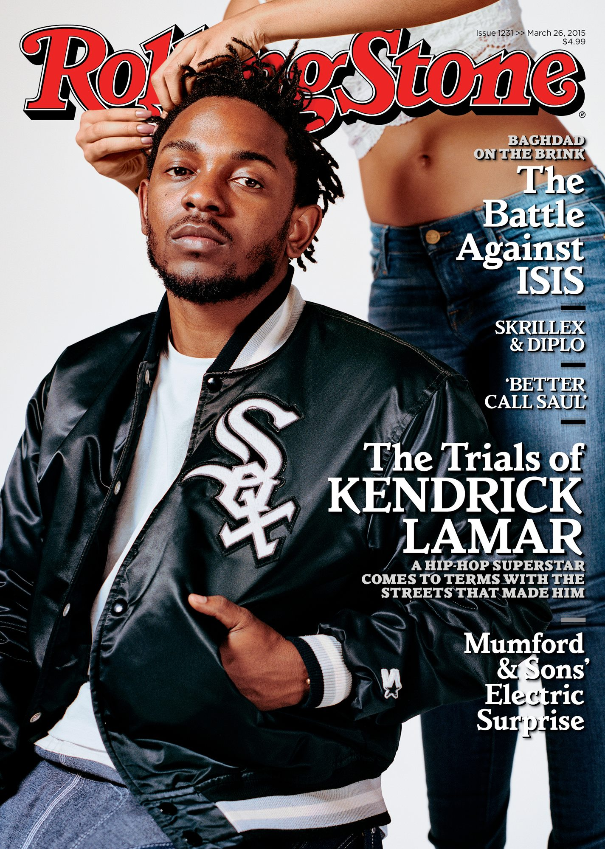
Who appeared on the cover of the first issue of Rolling Stone magazine?
3

Slide 14
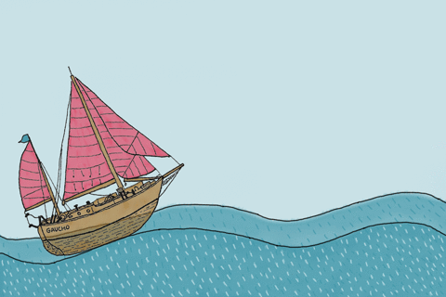
How many masts does a sloop have?
4

Slide 15
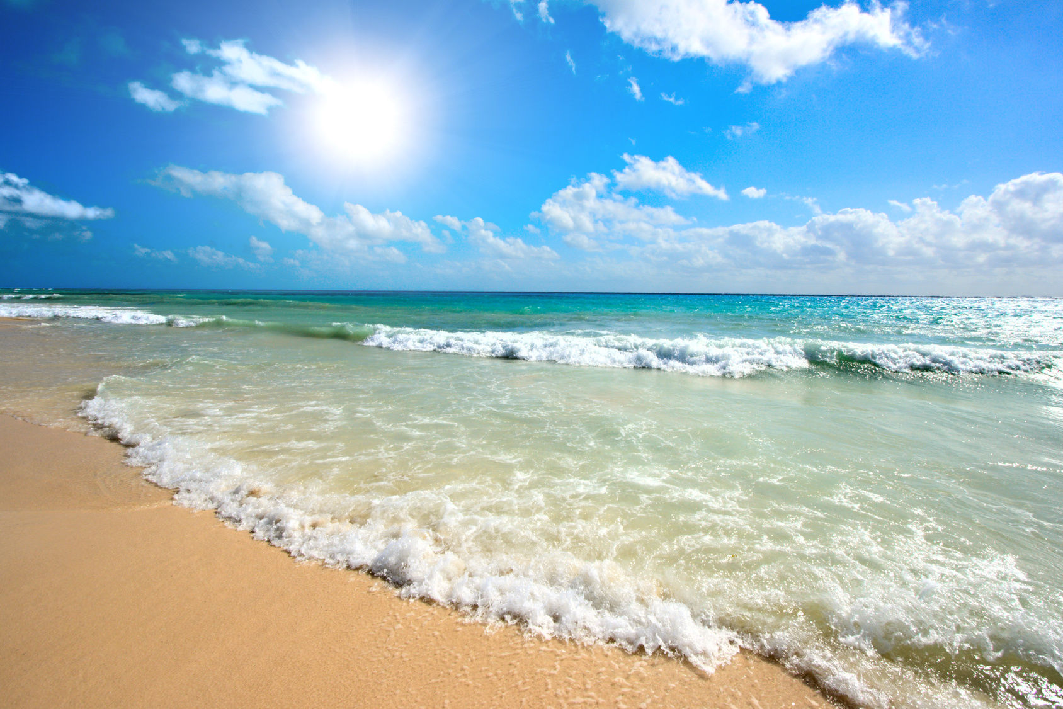
The famous Cable Beach is located west of which Australian town?
5

Slide 16
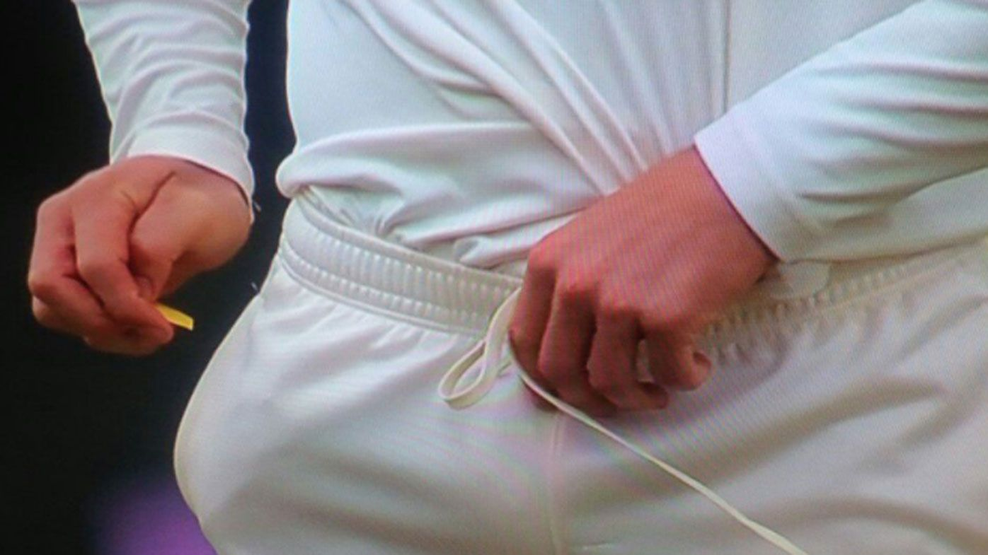
Which three Australian cricketers were banned over the 2018 ball-tampering scandal?
6

Slide 17


Slide 18
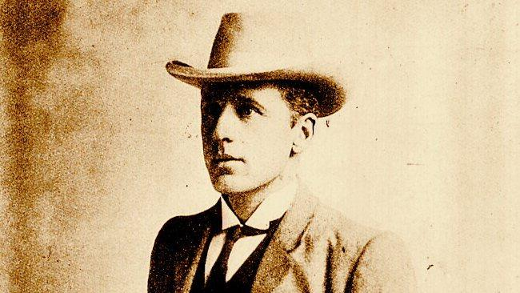
Who wrote the poem The Man from Snowy River?
Q1
A.B. (Banjo) Paterson

Slide 19

How many black squares are there on a chess board?
Q2
32

Slide 20
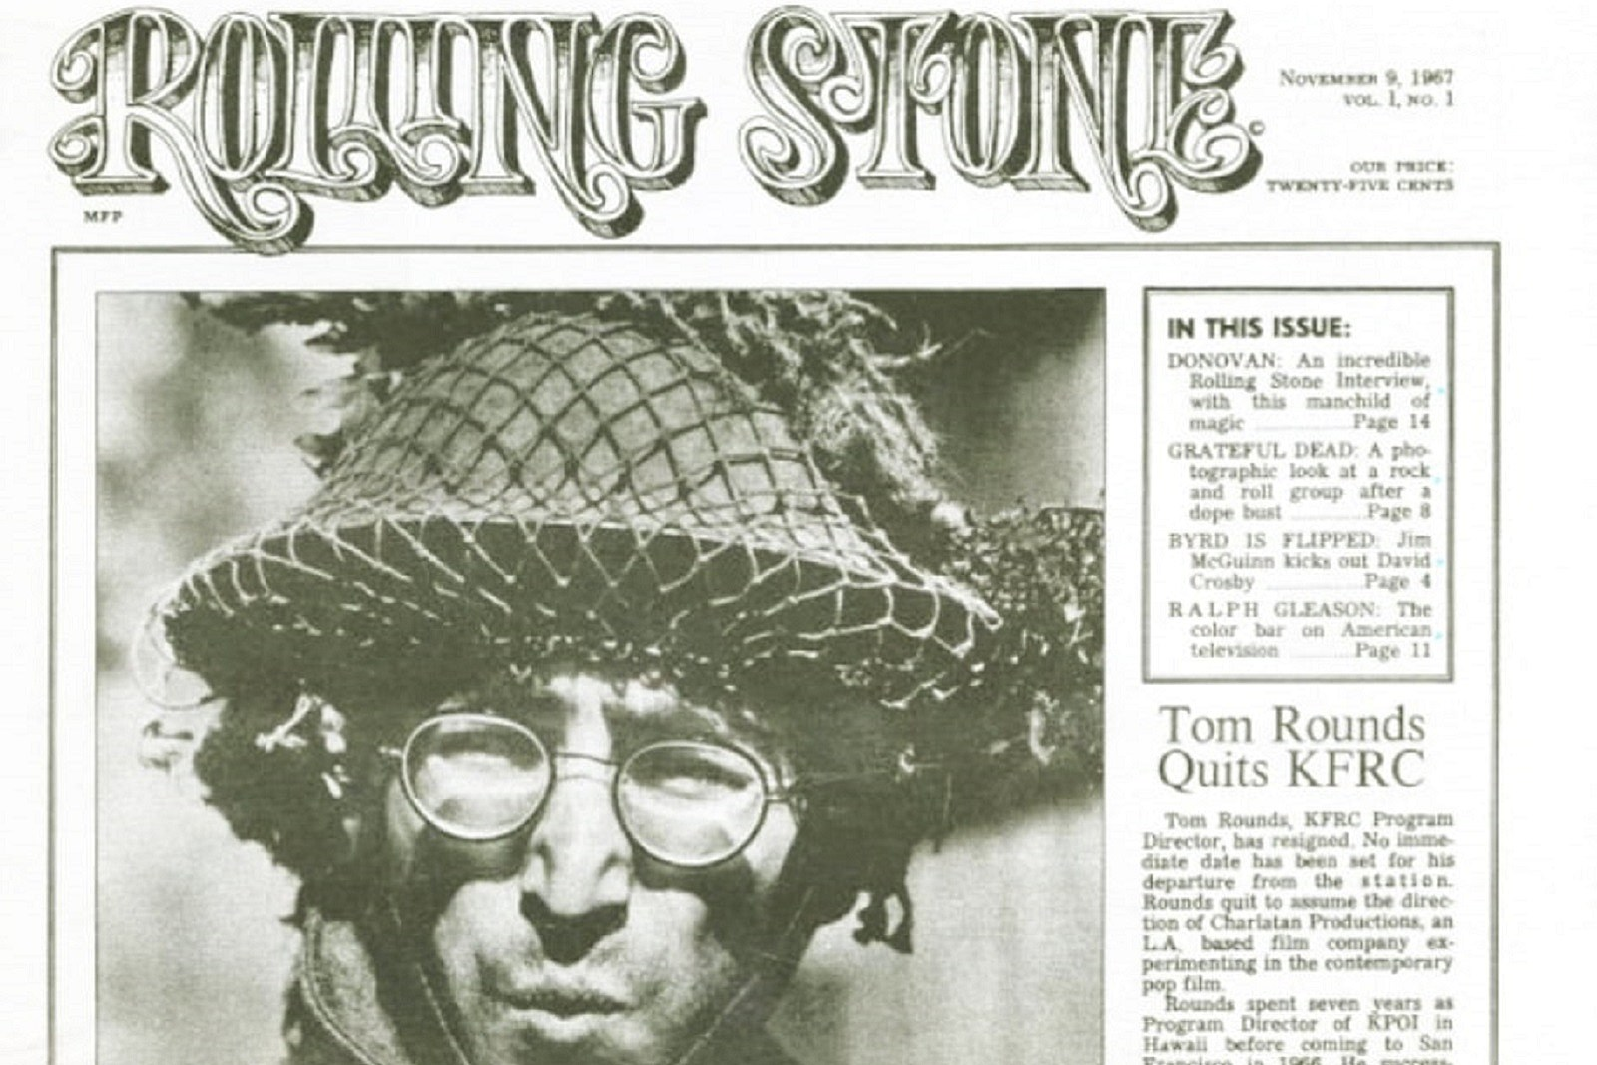
Who appeared on the cover of the first issue of Rolling Stone magazine?
Q3
John Lennon

Slide 21
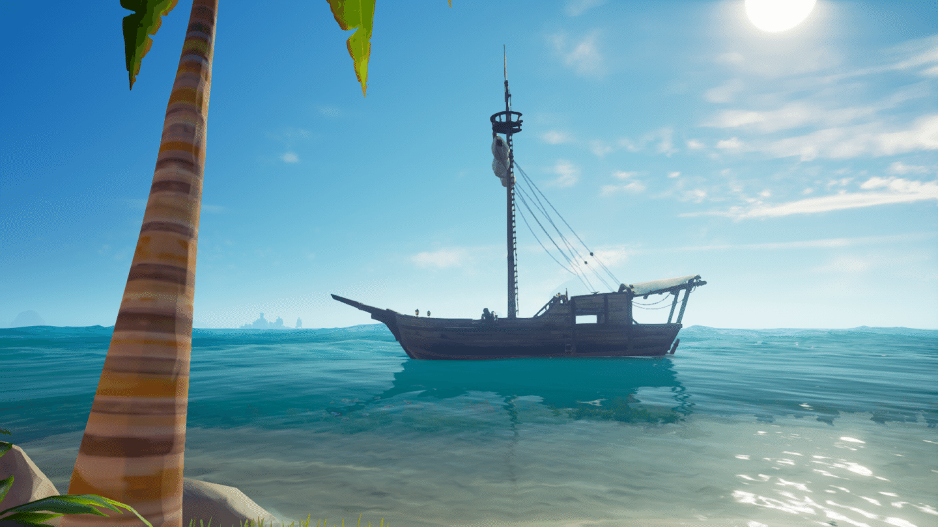
How many masts does a sloop have?
Q4
One

Slide 22
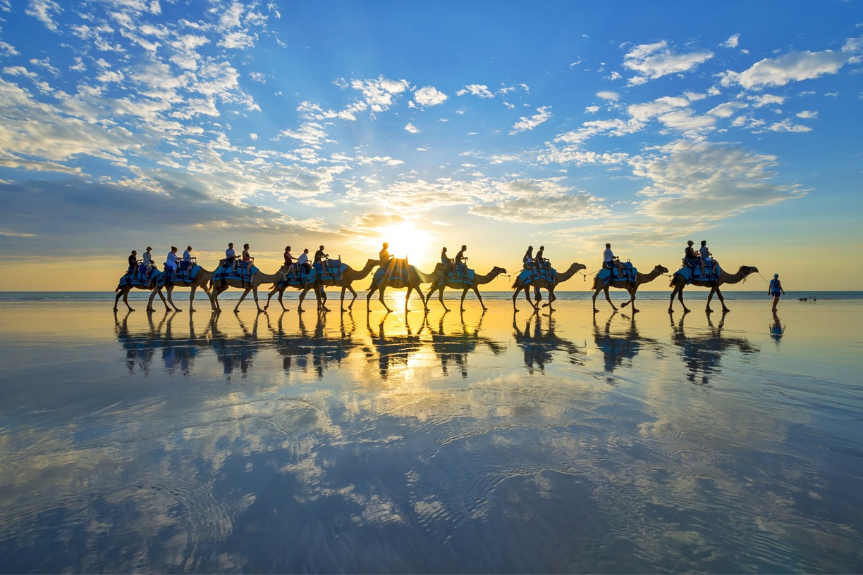
The famous Cable Beach is located west of which Australian town?
Q5
Broome

Slide 23
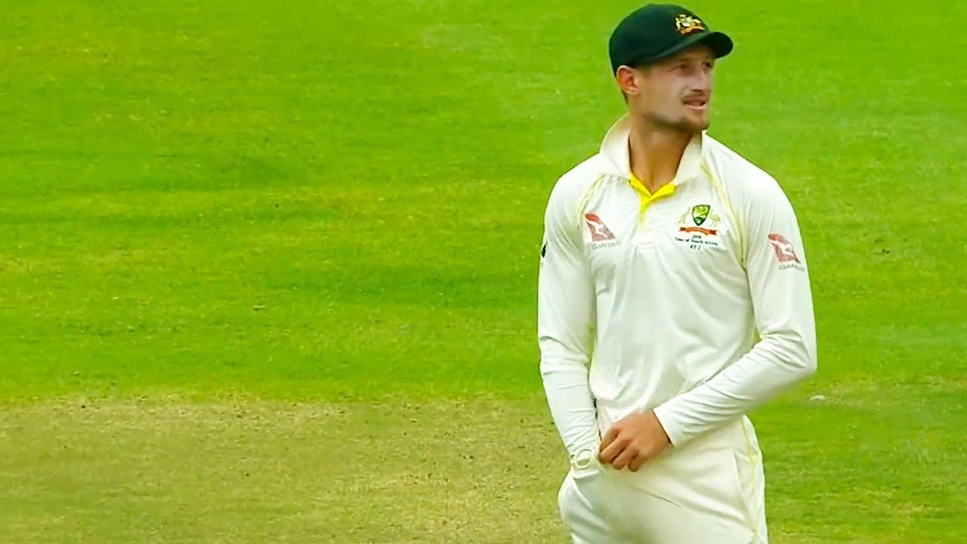
Which three Australian cricketers were banned over the 2018 ball-tampering scandal?
Steve Smith,
Dave Warner, Cameron Bancroft
Q6

Slide 24


Slide 25
